Slide 1
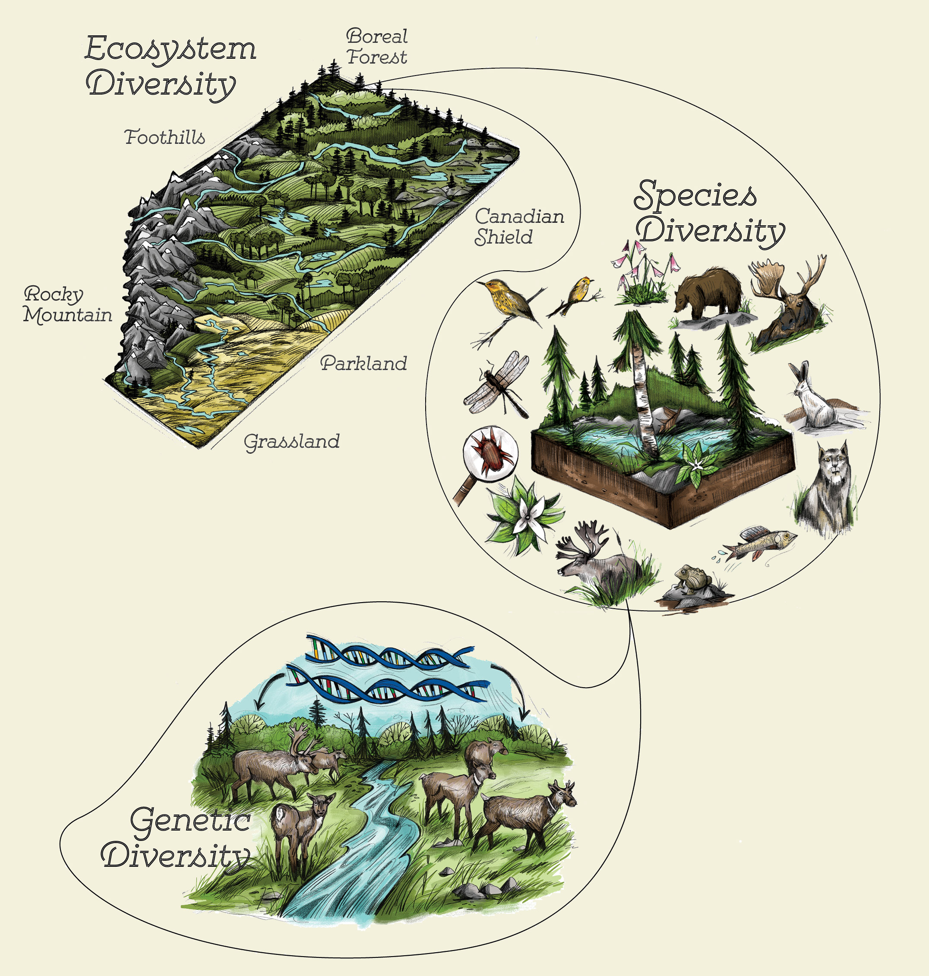
Biodiversity

Slide 2
Biodiversity
. . . the variety of life within a given system
Greater biodiversity = greater resiliency (able to survive a disturbance)

Slide 3
Biodiversity
Two types:
Genetic biodiversity
Species richness
Disturbances can include:
Fire
Drought
Disease
Hurricane

Slide 4
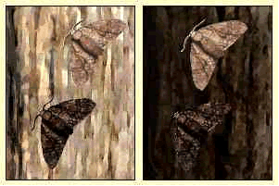
Genetic Diversity
. . . variety of genes/traits within a single population (of a single species)
Reduces chance of entire population dying after an environmental change
Greater variety of genes = greater chance that some members of the population will be suited to new environment
Example: peppered moths

Slide 5
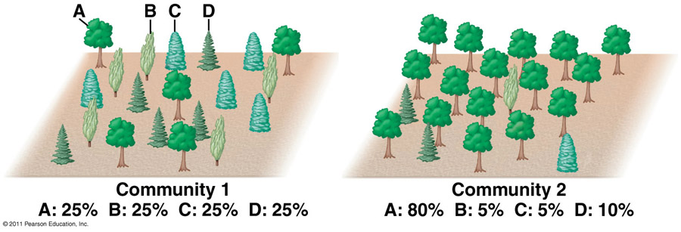
Species Richness
. . . variety of species within a single ecosystem
Stabilizes the ecosystem as a whole
One species dies off, another is able to fill its role (niche) rather than the entire ecosystem collapsing
Example: Dutch Elm Disease

Slide 6
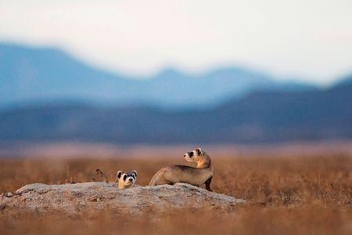
Blackfooted Ferrets
Play video →
Biodiversity Lab

