Slide 1
Deforestation & Sustainability

Slide 2
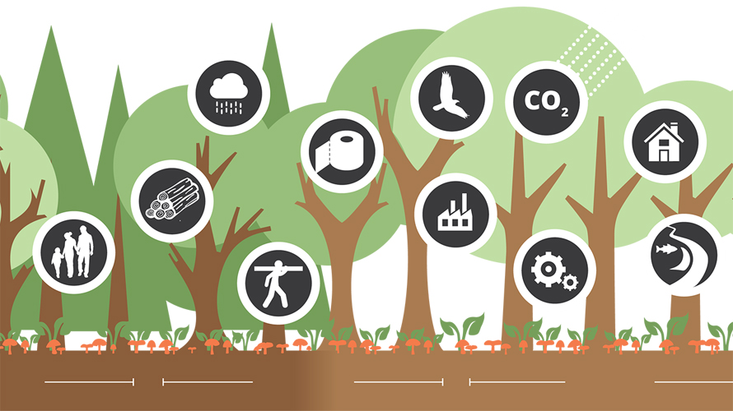
Forest Value
Ecological
Habitat
Biodiversity
Economic
Timber
Goods (paper, nuts, toxol, carnauba wax, etc.)
Recreation
Hiking
Camping
Oxygen via photosynthesis

Slide 3
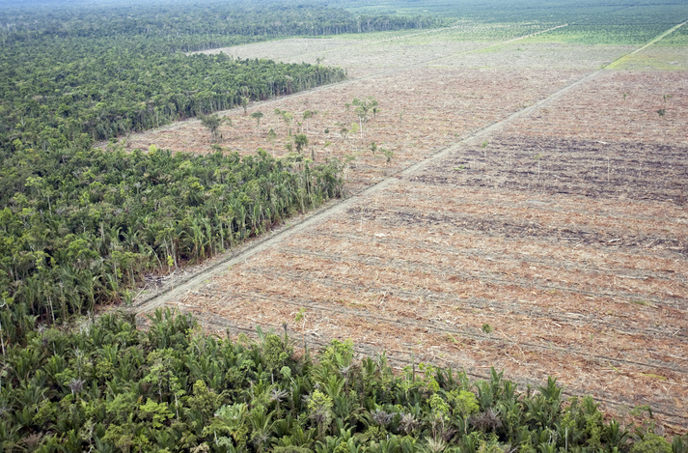
Deforestation

Slide 4
Deforestation
Clearing (cutting down) a forest
Clear-cutting—cutting down all trees
Slash & burn—cut down trees & burn stumps
Why?
Unhealthy stand (group of trees)
Timber
Goods
Land for agriculture, homes, roads, etc.
Drawbacks
Loss of biodiversity (increase chances of extinction)
Loss of habitat
Loss of potential new goods
Takes decades to regenerate (regrow)

Slide 5
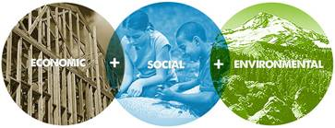
Sustainable Forest Management
Focuses on the immediate, short-term, and long-term survival of the forest while still using the resource
Uses different methods of harvesting based on the current condition of the forest and future goals
Considers environmental, economic, and recreational value

Slide 6
Methods of Harvesting Whiteboard
Title
Description
Positives
Negatives
Illustration/Diagram

Slide 7
Types of Harvesting
Type | Description | Positives | Negatives
Selective Cutting
Thinning—Large Diameter
Thinning—Small Diameter
Prescribed Burn
Clear Cutting

