Slide 1
Ground Water
Aquifers
Karst Topography

Slide 2
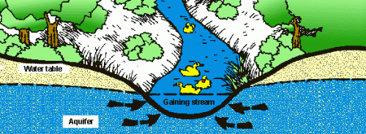
Background Information: Ground Water
Is stored underground in porous rock
Includes water in aquifers, caves, underground rivers, etc.
Human importance: primarily well water supply
Environmental importance: supplies water to lakes, rivers, etc. during droughts

Slide 3
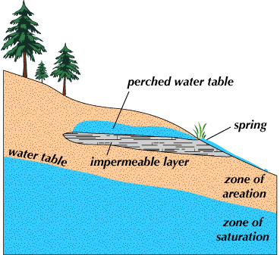
Ground Water Zones
Zone of Aeration — soil above the water table filled mostly with air
Zone of Saturation — area below water table where space is filled with water

Slide 4
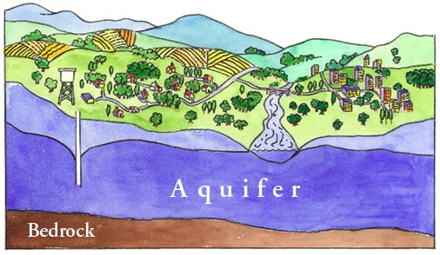
Aquifers
Porous layers of underground rock that
Are saturated with (full of) water
Have a nonporous rock layer below

Slide 5
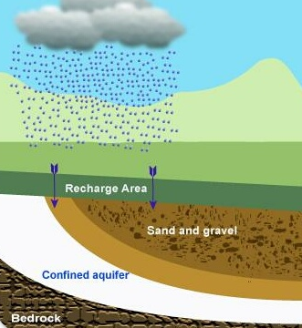
Aquifers (continued)
Recharge (refill) through infiltration
Infiltration—surface water sinks into the soil; ties to permeability
Soils with high porosity/permeability = high/fast infiltration

Slide 6
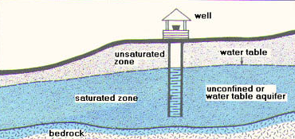
Aquifers: Wells
Wells—pumps that bring water from an aquifer up to the surface
Artesian wells are naturally occurring wells
Wells must be drilled/inserted into the aquifer (but not through it) in order to work

Slide 7
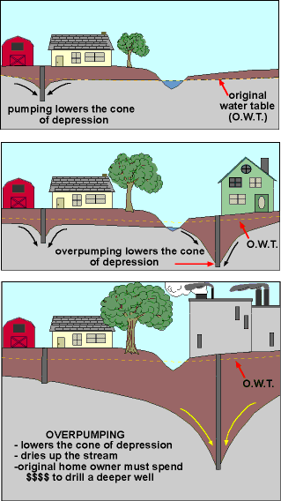
Ground Water Issues: Cone of Depression
Water is removed from an aquifer faster than surface water can recharge it, causing local ground water level to drop
Main cause = over-pumping of water from wells

Slide 8
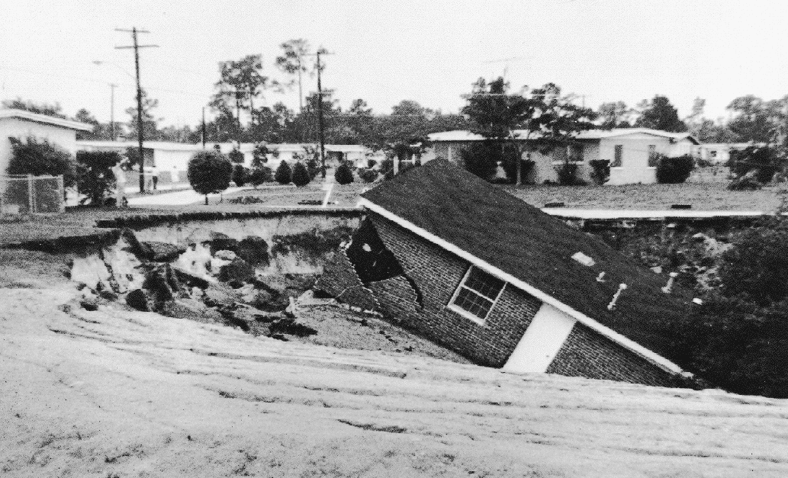
Ground Water Issues: Subsidence
Too much water is removed from the aquifer and causes the ground above to collapse, forming a sink hole

Slide 9
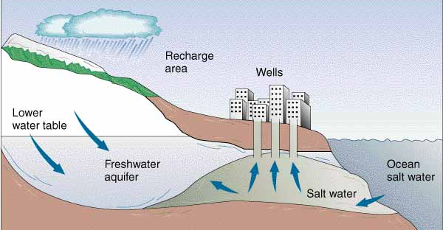
Ground Water Issues: Saltwater Intrusion
A depleted (emptied) coastal aquifer does not recharge fast enough through infiltration, so ocean water seeps into the aquifer from below ground

Slide 10
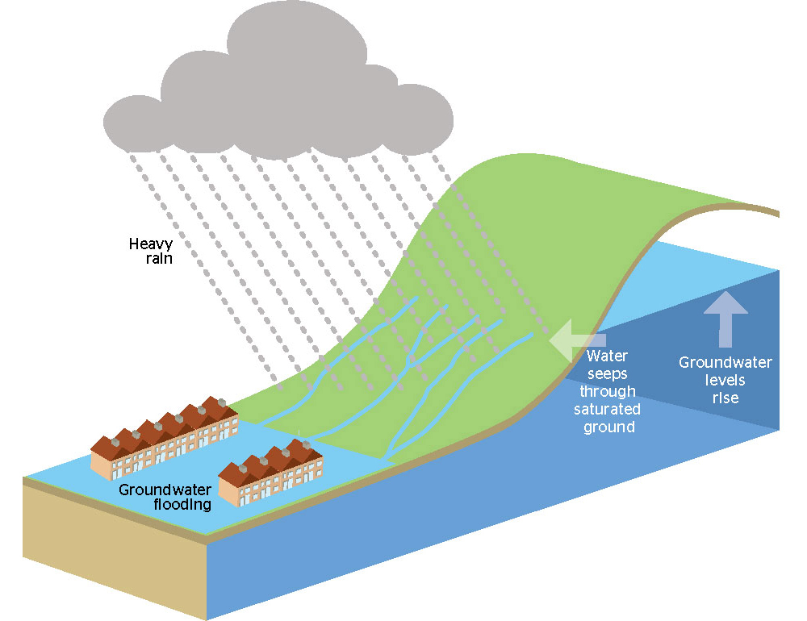
Ground Water Issues: Flooding
Occurs when water cannot get underground:
Infiltration = less than rain fall
Infiltration = less than runoff coming into area
Water table = close to surface

Slide 11
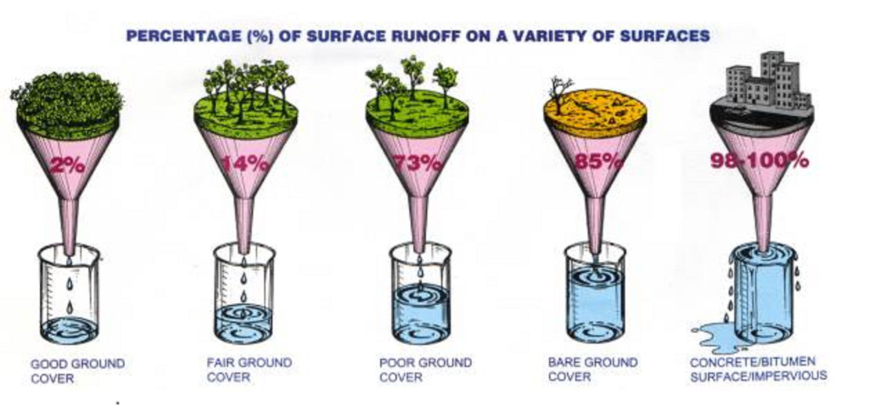
Ground Water Issues: Flooding
Increases with . . .
Removal of vegetation
Draining of wetlands (huge water storage)
Covering ground with impermeable surfaces (do not allow water through into the soil)

Slide 12
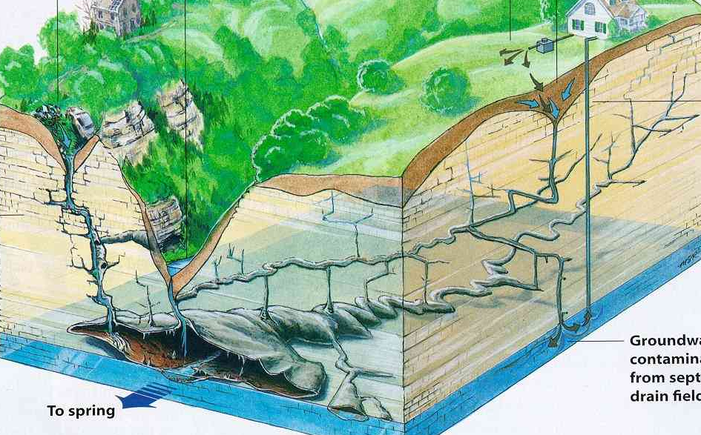
Karst Topography
A landscape with numerous caves, sinkholes, fissures, and underground streams
Usually occurs in areas with plenty of rainfall & bedrock that dissolves easily (ex. limestone)

Slide 13
Karst Topography Video Clip
Copy each of the following, leaving space to answer them during the video clip:
Describe how water acts on Earth's surface to create caves.
Describe two processes that form sinkholes.
Describe three features of “karst topography.”
Are karst water systems vulnerable to pollution? Why/why not?

Slide 14
Karst Topography Video Clip
http://www.pbslearningmedia.org/resource/ket09.sci.ess.structure.karst/karst-topography-and-mammoth-cave/

