Slide 1
Invasive Species

Slide 2
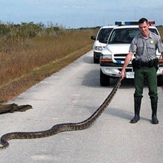
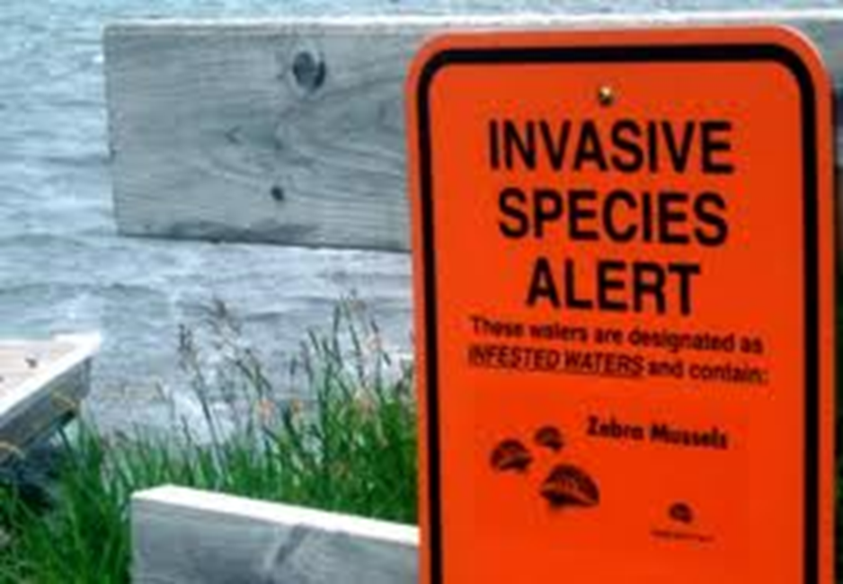
Invasive species
Non-native/introduced to an ecosystem (did not evolve in or slowly enter an area)
Can be plants, animals, etc.

Slide 3
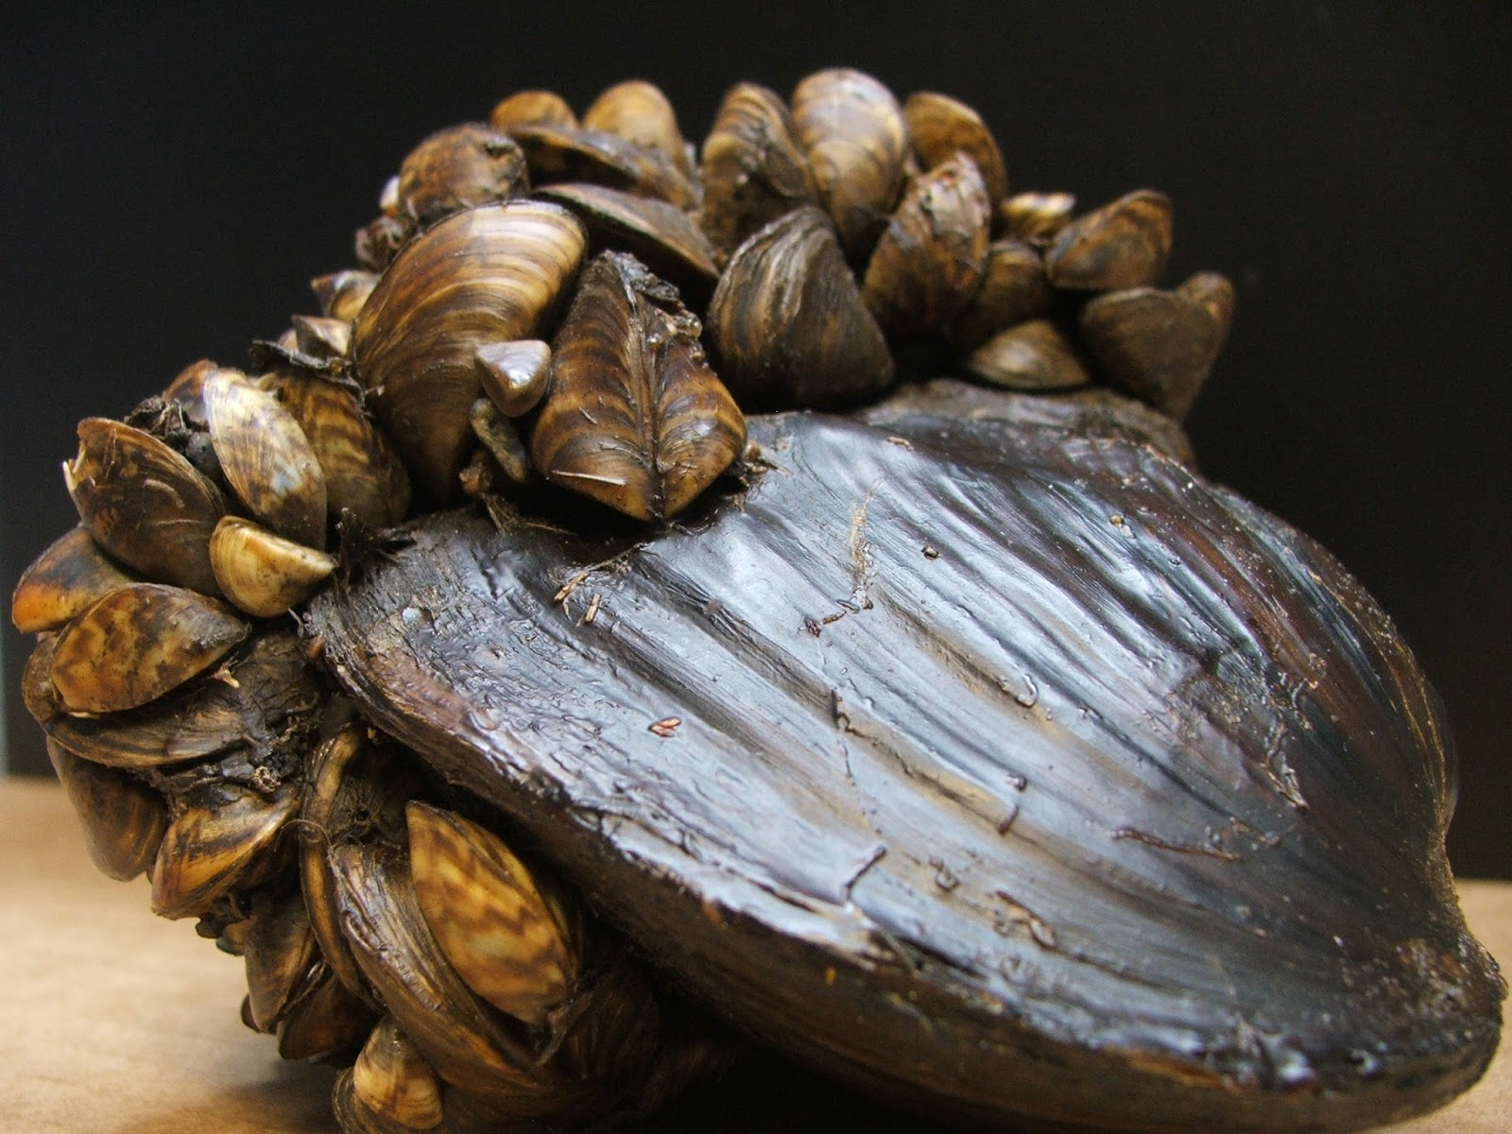
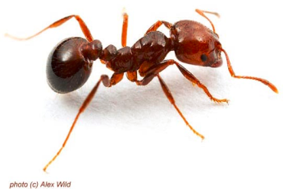
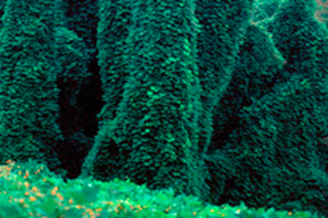
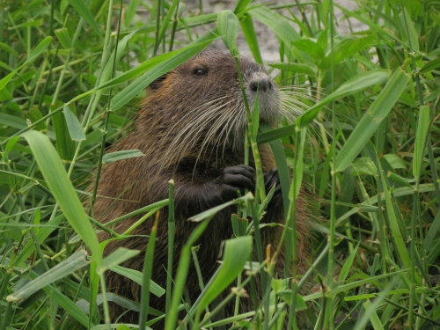
Means of Introduction
Primarily through people
Unintended
Zebra mussels
Fire ants
Intentional
Kudzu
Nutria

Slide 4
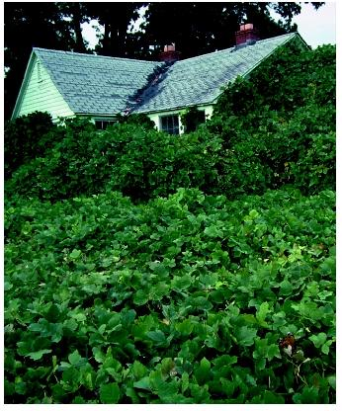
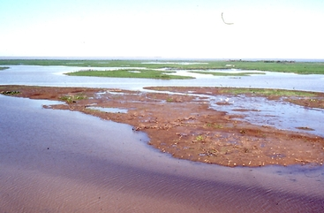
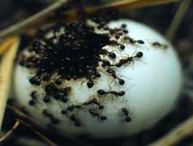
Effects on New Ecosystem
No natural predators to stop them . . . .
Uncontrolled population growth
Out-compete native species for resources
Uncontrolled consumption of prey
Change in apex predator

Slide 5
Prevention
Select native garden/yard plants
Clean boats (inside & out) as soon as removed from a body of water
Clean boots before leaving an area (seeds, pathogens)
Inspect fruits, vegetables, plants, insects and animals for pests
Keep pets as pets!!!—don't release aquarium fish, plants, live bait, or other exotic animals into wild

