Slide 1
Moderation of Coastal Climates
Via Energy Transport
Via Heat Sink

Slide 2
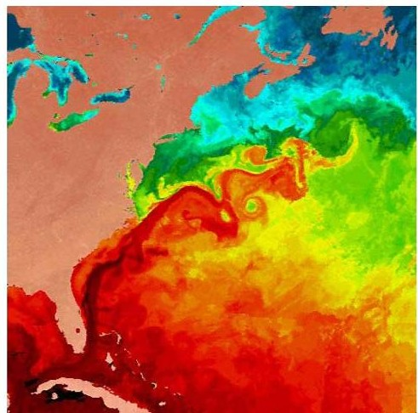
Oceans as Energy Transporters: Warm Currents
Oceans move energy via currents.
Warm Currents:
An ocean current beginning near the equator moves warm water.
When warm water moves into an area, the local air temperature increases.

Slide 3
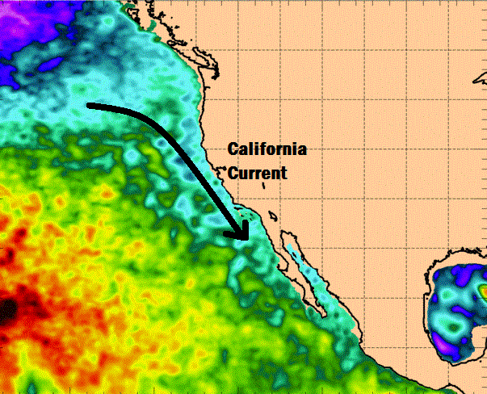
Oceans as Energy Transporters: Cold Currents
Oceans move energy via currents.
Cold Currents:
An ocean current beginning near the Earth’s poles moves cold water.
When cold water moves into an area, the local air temperature decreases.

Slide 4
Oceans as Energy Transporters: Example
The NC coast is warmer than the California coast at the same latitude because . . .
NC is next to the warm Gulf Stream moving up from the equator.
CA is next to the cold California current moving down from Alaska.

Slide 5
Oceans as Heat Sinks
Heat sinks . . .
are objects/substances that store large amounts of energy.
have a high specific heat capacity.
Specific heat capacity = amount of energy needed to raise the temperature of the substance.
High s. h. c. = heats up slowly & cools down slowly.
Low s. h. c. = heats up quickly & cools down quickly.

Slide 6
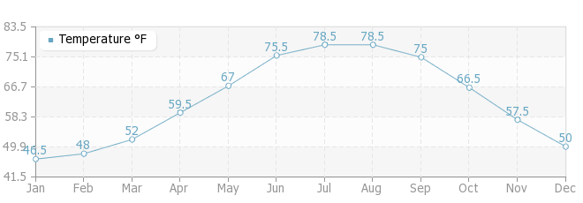
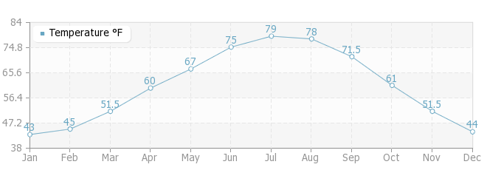
Heat Sinks and Climate: Temperature Change
Water = very high specific heat capacity
Slow change of ocean temp = slower temp change of the air near by.

Slide 7
Heat Sinks and Climate: Temperature Change
Slow change of temps = more moderate (less extreme) temps year-round.
In winter: coastal NC Outer Banks stays warmer longer & overall vs. center of NC near Raleigh.
In summer: coastal NC Outer Banks stays cooler longer & overall vs. center of NC near Raleigh.

Slide 8
Heat Sinks and Climate: Temperature Moderation
Since oceans provide a constant source & sink for energy, coastal temperatures tend to stay steadier than inland temperatures.

