Slide 1
Natural Resources & Ecological Footprints

Slide 2
Natural Resources . . .
are the materials provided by the Earth itself
Replenish (are replaced) through natural processes
used by ALL living organisms to sustain life
used by people for economic gain as well
Examples:
Air
Water
Land & soil
Minerals & rocks
Living organisms

Slide 3
Types of Natural Resources
Renewable
Can be used without significantly reducing the amount available
Replenish within months, years, or decades
Rate of replenishment is greater than or equal to rate of use
Examples: water, wind, oxygen, timber
Nonrenewable
Can NOT be used without significantly reducing the amount available
Replenishment/formation takes millions of years
Rate of replenishment is less than rate of use
Examples: coal, natural gas, petroleum, uranium

Slide 4
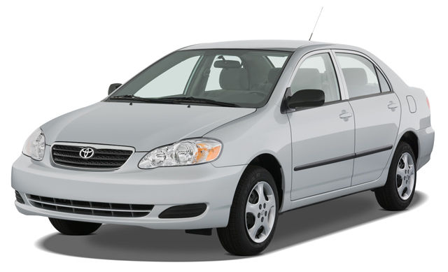
Cars: Renewable or Non-Renewable?

Slide 5
Resource Distribution
Natural resources are found in every part of the world
Natural distribution is NOT equal
Deserts lack water
Tundra lack trees
North America has few diamonds
Caribbean Islands have no emeralds
Greater natural resources = wealth & power

Slide 6
U.S. Natural Resources
U.S. has many different natural resources in relatively abundant supply
Timber
Freshwater
Coal
Often more resources = greater use per person = higher standard of living

Slide 7
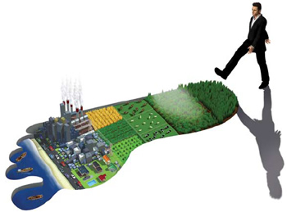
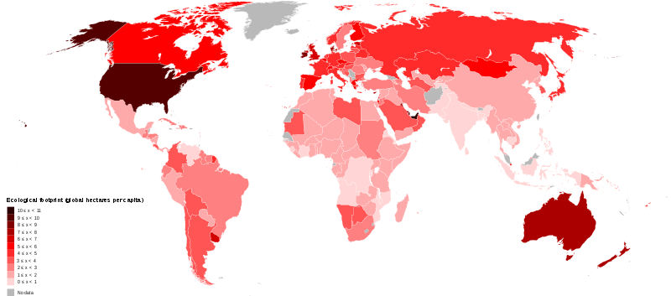
Ecological Footprint
Amount of land needed by each person for their food, water, transport, housing, and waste management
Higher standard of living = higher resource use = bigger ecological footprint

Slide 8
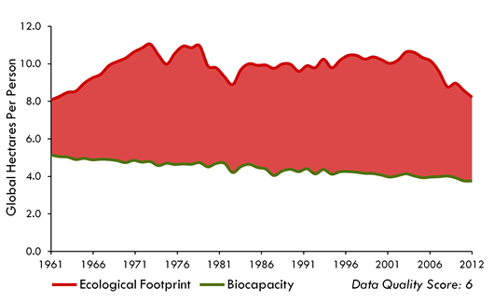
U.S. Ecological Footprint
Use ~25% of world’s resources
Have ~5% of world’s population

Slide 9
