Slide 1
Population Growth
Unit 8

Slide 2
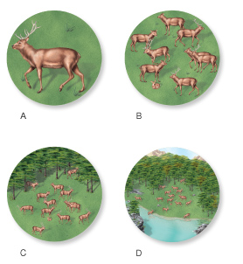
Population Size
. . . number of individuals of the same species living in the same place at the same time
Size proportional to resource needs
Notes:
Improvements in agriculture, sanitation, and medical care have enabled the human population to grow enormously in the last few 100 years. As the population grows, consumption, waste, and the overuse of resources also grow. People are beginning to discuss and carry out sustainable development that decreases the impact humans have on the planet.

Slide 3
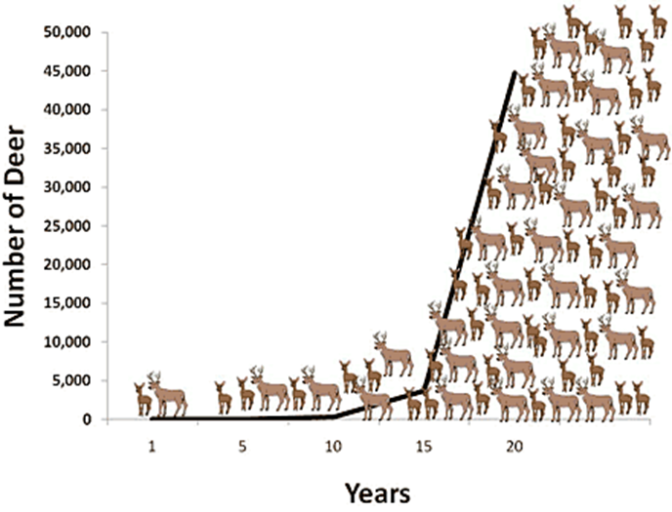
Population Graphs

Slide 4
Change in Population Size
Increases: births & immigration (individuals move into an area)
Decreases: death & emigration (individuals move out of an area)

Slide 5
Population Growth
More births/immigration than deaths/emigration
Positive slope
Need more resources

Slide 6
Steady Population
Equal births/immigration and deaths/emigration
No/flat slope
No change in resource needs

Slide 7
Population Decline
Fewer births/immigration than deaths/emigration
Negative slope
Need fewer resources

Slide 8
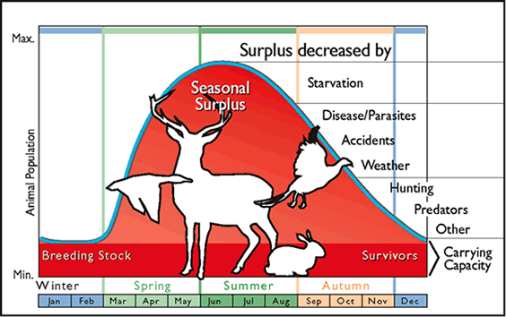
Limits on Population Growth
Biotic Potential: maximum biological ability of an individual or population to reproduce (think rabbits vs. people)
Limiting factors: environmental constraint on population size

Slide 9
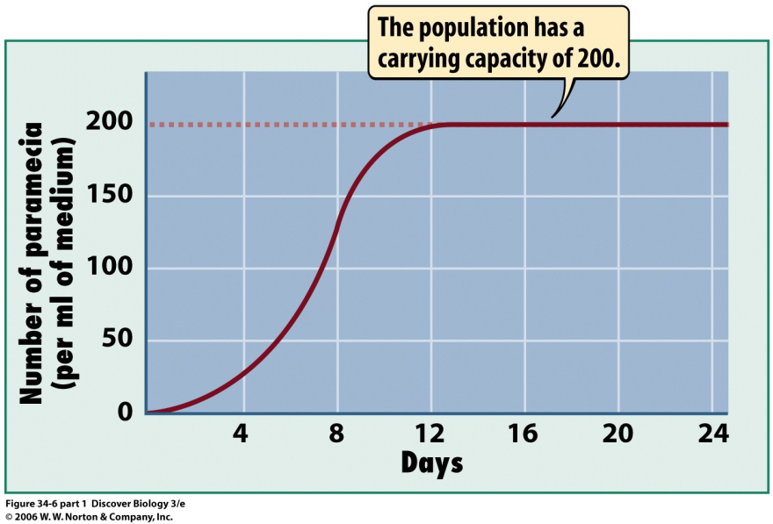
Carrying Capacity
Maximum sustainable (steady) population
Notes:
The carrying capacity depends on biotic and abiotic factors. If these factors improve, the carrying capacity increases. If the factors become less plentiful, the carrying capacity drops. If resources are being used faster than they are being replenished, then the species has exceeded its carrying capacity. If this occurs, the population will then decrease in size.

Slide 10
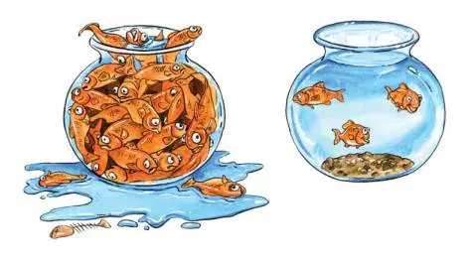
Limiting Factors
Determine the carrying capacity of a population
Examples:
Disease
Predation
Food Resources
Habitat Size
Competition
Notes:
If the limiting factor decreases, the population decreases. If the limiting factor increases, the population increases. If a limiting factor increases a lot, another factor will most likely become the new limiting factor.
This may be a bit confusing so let's look at an example of limiting factors. Say you want to make as many chocolate chip cookies as you can with the ingredients you have on hand. It turns out that you have plenty of flour and other ingredients, but only two eggs. You can make only one batch of cookies, because eggs are the limiting factor. But then your neighbor comes over with a dozen eggs. Now you have enough eggs for seven batches of cookies, and enough other ingredients but only two pounds of butter. You can make four batches of cookies, with butter as the limiting factor. If you get more butter, something else will be limiting.

Slide 11
Limiting Factors: Density Dependent
Using the reading/notes sheet provided . . .
Describe
Examples

Slide 12
Limiting Factors: Density Independent
Using the reading/notes sheet provided . . .
Describe
Examples

Slide 13
Population Growth
Three population growth curves :
Linear Growth
Exponential Growth
S-Curve

Slide 14
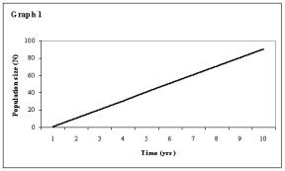
1. Linear Growth
Population increases at the same speed over time
Example: 40 individuals every 3 years

Slide 15
2. Exponential Growth
Population increases at an ever-faster pace
Example:
250 yrs = 5,000
60 yrs = +5,000
40 yrs = +5,000
30 yrs = +5,000

Slide 16
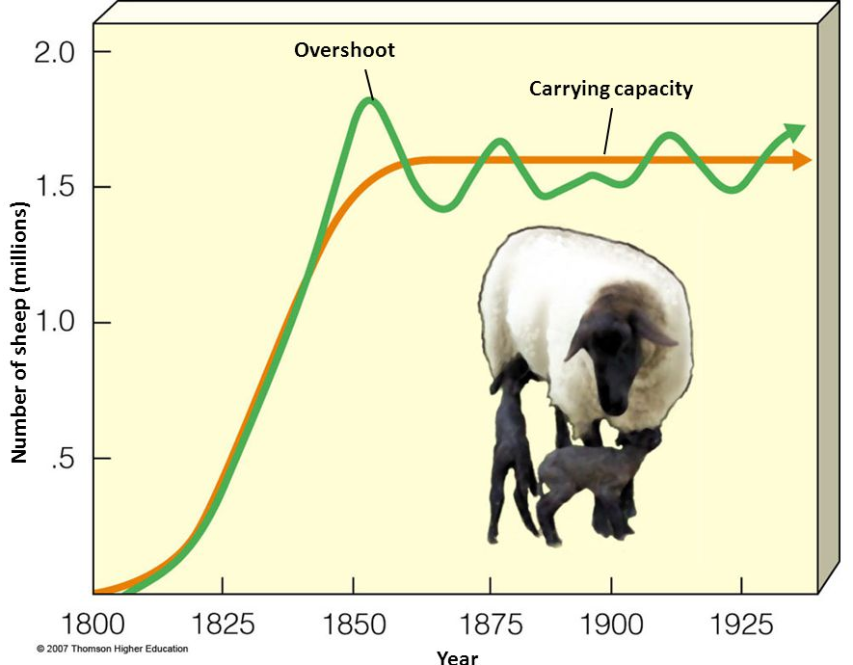
S-Curve
NO population can grow forever
At some point resources run out
Population reaches carrying capacity
Example: population hovers around 1.6 million

Slide 17
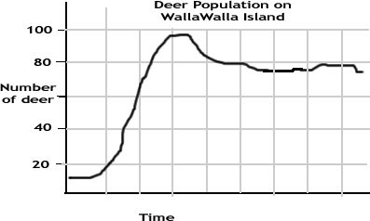
Growth type:
Carrying capacity:
Peak population:
Area of population decline:

