Slide 1
Sea Level Change on a Global Scale
Glaciers
Ice Ages
Plate Tectonics
Air/Water Temperature

Slide 2
Changes in Global Sea Level: Glaciers
If glaciers . . .
Melt = rising sea levels
Refreeze = decreasing sea levels
Currently, the melting of glaciers is causing a slow rise in the average global sea level (1-2 mm/year).

Slide 3
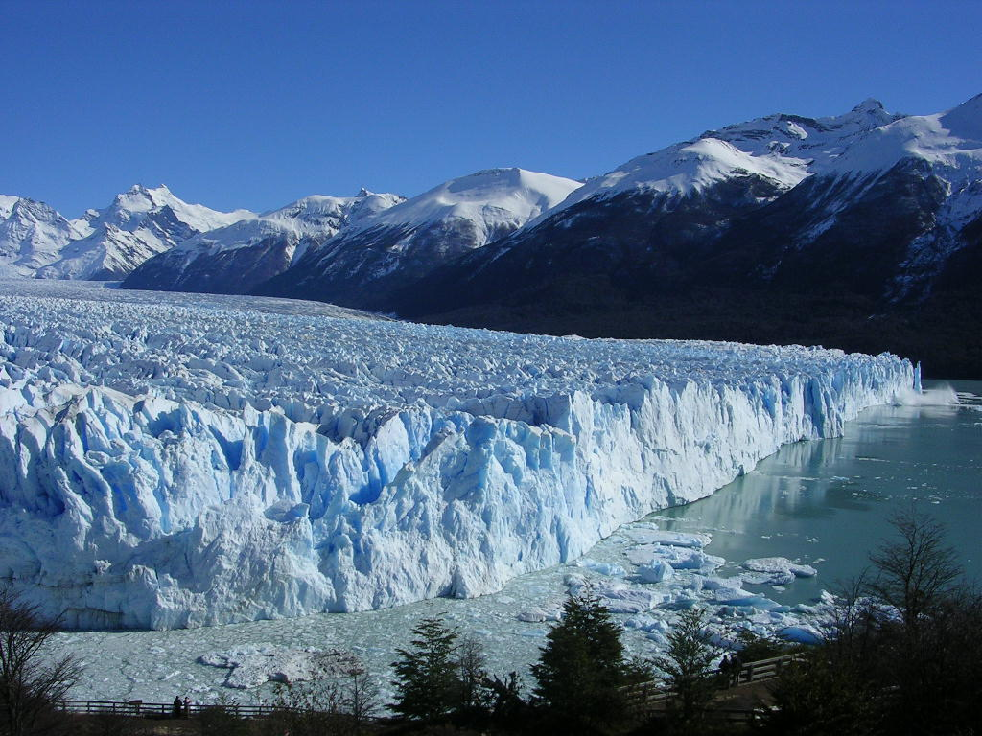
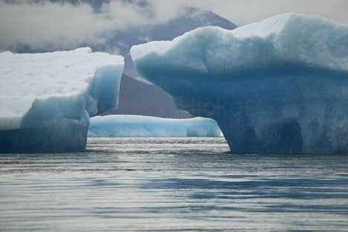
Changes in Global Sea Level: Ice Ages
DURING an ice age, sea levels decrease.
AT THE END OF an ice age, sea levels increase.
Currently, Earth is not in or at the end of an ice age.

Slide 4
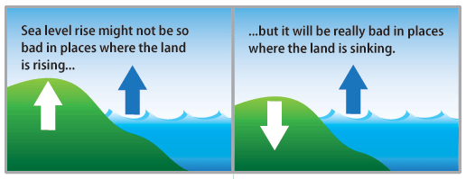
Changing the Ocean: Plate Tectonics
Plate tectonics change sea level by changing the configuration and amount of land.
Increased land area = increase in sea level
Decreased land are = decrease in sea level
Currently, the land area is decreasing and would lower sea levels 0.3mm/year IF there were NO other factors!

Slide 5
Current Change in Global Sea Level
It is RISING!
Why?
Increase in the average global temperature
Causes melting of glaciers, sea ice, and the polar ice caps
Thermal Expansion
As the ocean temperature increases, the water expands on a molecular level, taking up more space, making the oceans deeper.

Slide 6
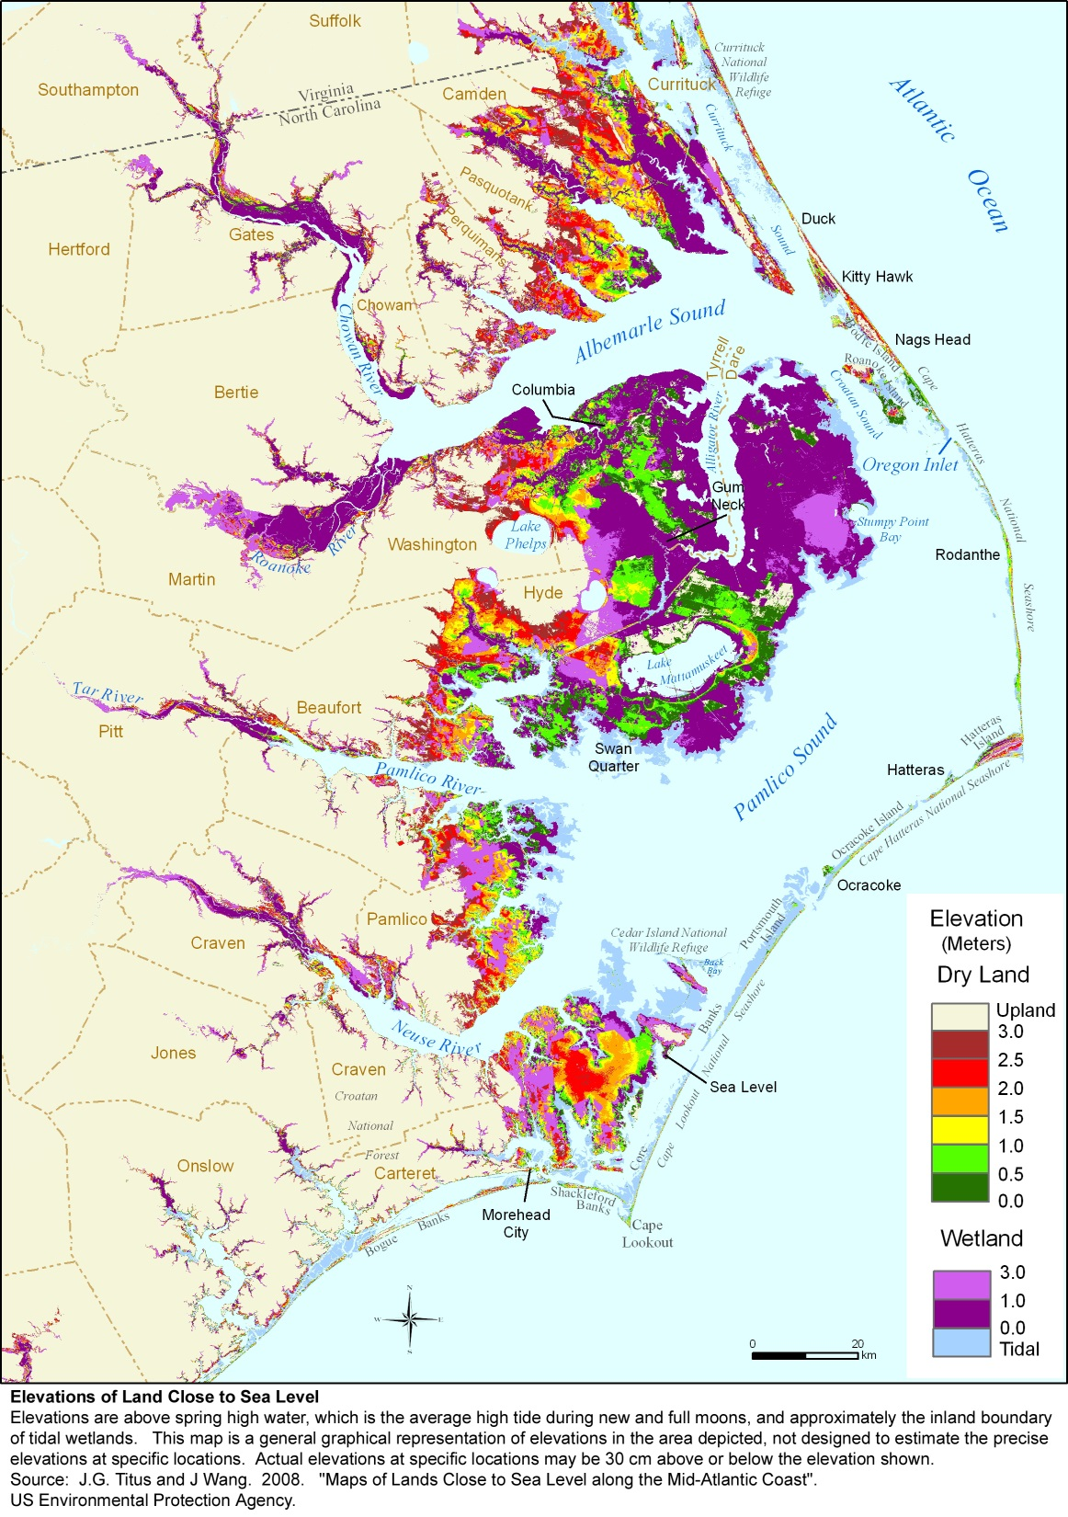
Effects of Rising Sea Level
Flooding of coastal areas
Destruction of estuary habitat (no other similar habitat for those organisms)
Increased salt water intrusion in coastal areas

