Slide 1
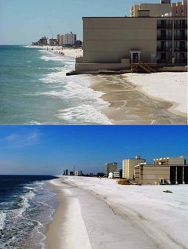
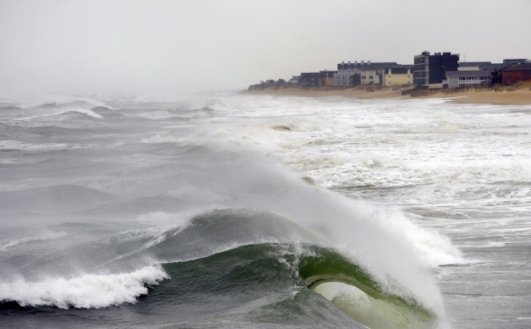
Shoreline Features

Slide 2
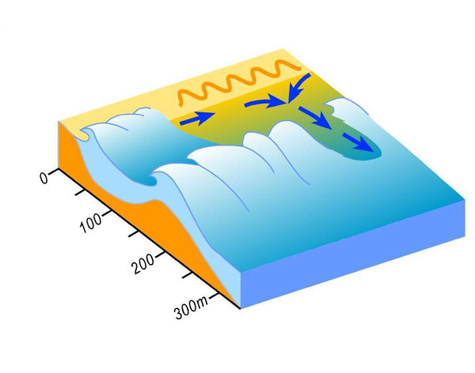
Shoreline Currents
Longshore current
Rip current

Slide 3
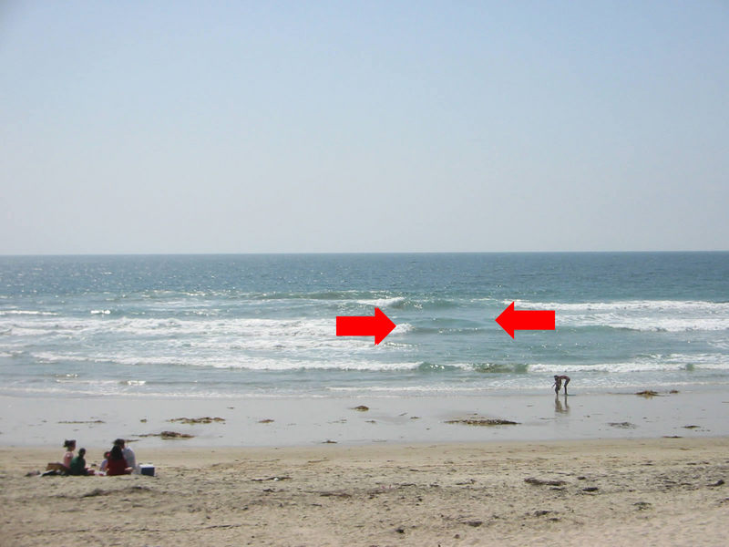
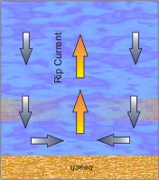
Shoreline Currents
Longshore current: flows parallel to shore
Rip current: strong currents that flow out to sea through gaps in the longshore bar.

Slide 4
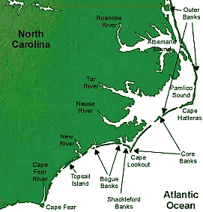
Barrier Islands (like the NC Outer Banks)
Long ridges of sand separated from mainland
Deposited by longshore currents
Highly unstable
Protect mainland beaches & ecosystems from storm surges

Slide 5
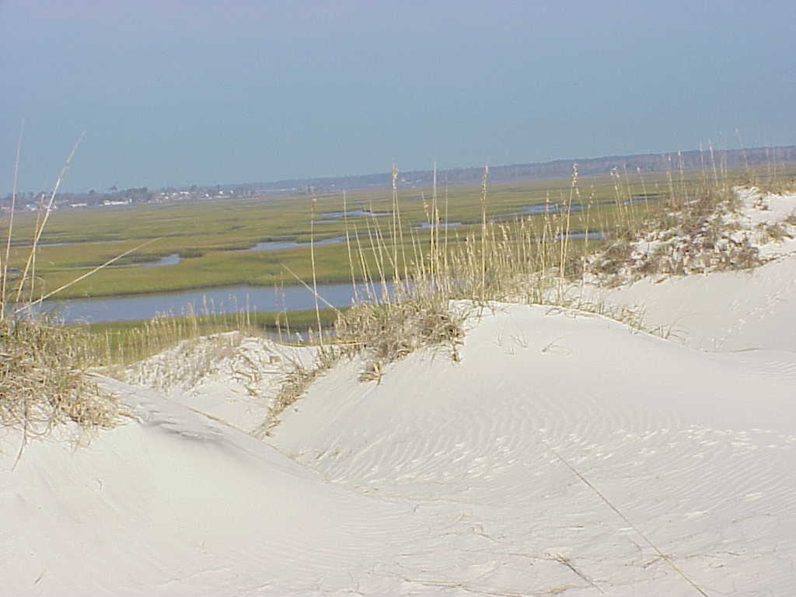
Sand Dunes
Can have grass on them
Provide habitat for a variety of creatures: birds, rodents, crustaceans
Highly unstable & will shift over time due to wind & water currents

Slide 6
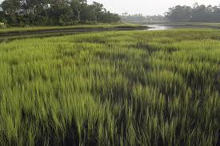
Estuaries and Salt Marshes
Form when rivers empty into a body of salt water (aka an ocean) and deposit sediment at the mouth
Host to numerous plant & animal species (birds, mollusks, a juveniles)
Filter water
Trap sediment
Shallow
Very little open water

Slide 7
Beaches – large deposit of sand at a shoreline
East Coast (Irregular)
West Coast (Regular)
Wide and flat
Many inlets and bays
Narrow and steep
Relatively straight line

Slide 8
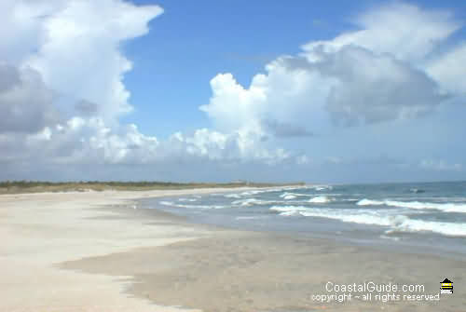
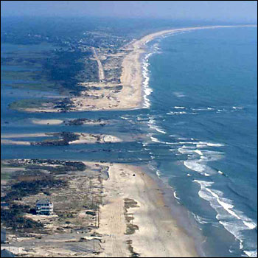
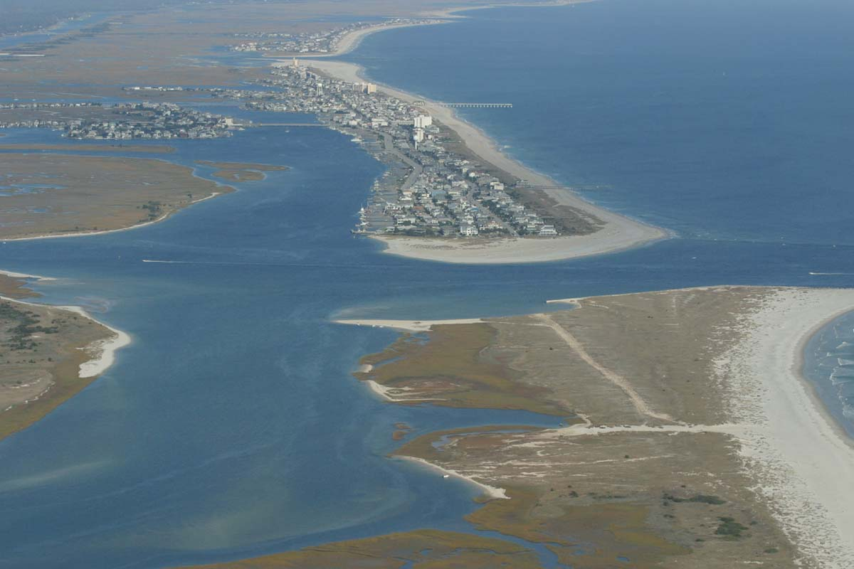
East Coast Beaches

Slide 9
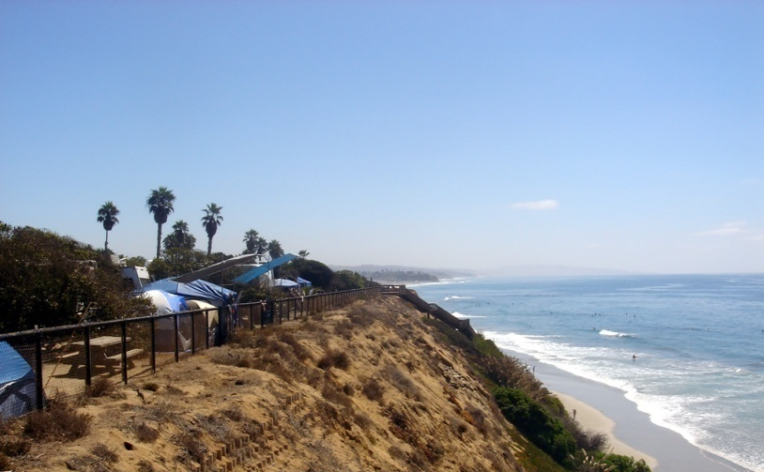
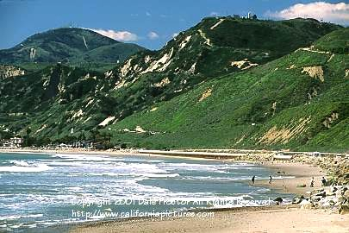
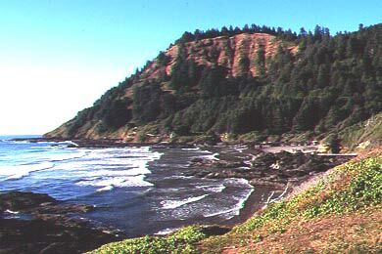
West Coast Beaches

