Slide 1
Soil Properties
Particle Size
Texture
Porosity
Permeability
Holding Capacity

Slide 2
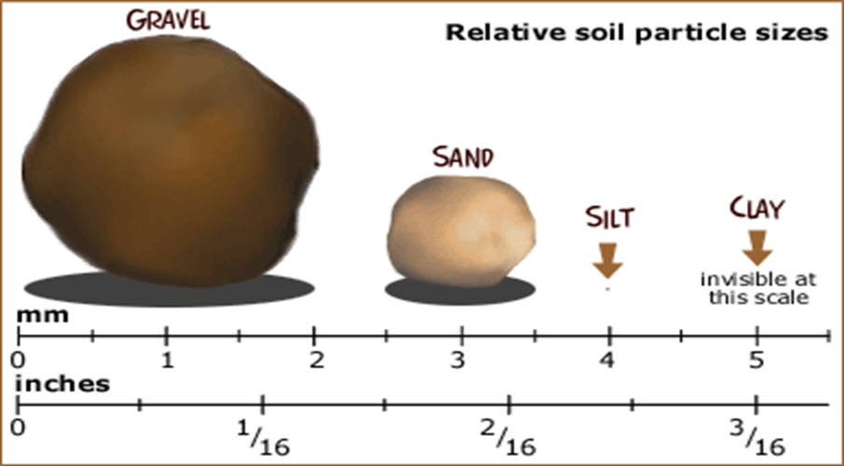
Station 1a: Particle Size
Responsible for all other soil properties
Action: Use the image below to determine the relative sizes of the particles and record. Use terms like largest, smallest, etc.).

Slide 3
Station 1b: Texture
How the soil feels . . . gritty, smooth, etc.
Responsible for all other soil properties
Action: Feel each type of soil between your fingers to determine texture and record.
Moisten a small amount of 1 material.
Rub the material between your fingers and thumb.
Return the material to the cup.
Repeat steps 1-3 for all 3 materials.
Wash your hands!!!

Slide 4
Station 2: Porosity
The amount of air/space between particles
Action: Determine the relative amount of space between particles
Fill 1 cup to the 2 cm line with sand. Break up any clumps but do not pack down the material.
Fill a graduated cylinder with 40 mL of water.
SLOWLY pour the water into the cup UNTIL it reaches the 2 cm line. Record how much water you added to the cup.
Repeat the above process with the pre-filled gravel cup.
Using the water absorbed to indicate how much space is between the particles, rank the relative porosity of each material using the terms high and low.
Carefully pour off the water from both cups. Put the sand in the disposal container. Dry and return gravel to the cup.

Slide 5
Station 3: Permeability
The rate water flows through soil
Action:
Check that there are 2 beakers set up, 1 with a cup of gravel & another with a cup of clay over top. The cups have a hole in the bottom.
Measure out 25 mL of water in a graduated cylinder.
Pour 25 mL of water into the gravel cup and let it drip out of the cup into the beaker. The clay cup already has water added to it—do NOT add more—OBSERVE! Record the speed of the water as fast or slow.
Using the speed as an indicator, rank the relative permeability of each material using the terms high and low.
Empty the water from the beaker with the gravel cup. Drain water from the cup with gravel but do NOT empty the cup! Do NOT touch the clay set up!

Slide 6
Station 4: Holding Capacity
The ability of soil to trap water or nutrients
Action:
Check that there are 2 beakers set up, 1 with a cup of gravel & another with a cup of clay over top. The cups have a hole in the bottom.
Measure out 25 mL of water in a graduated cylinder.
Pour 25 mL of water into the gravel cup and let it drip out of the cup into the beaker. The clay cup already has water added to it—do NOT add more—OBSERVE! Record the speed of the water as fast or slow.
Using the speed as an indicator, rank the relative holding capacity of each material using the terms high and low.
Empty the water from the beaker with the gravel cup. Drain water from the cup with gravel but do NOT empty the cup! Do NOT touch the clay set up!

