Slide 1
Upwelling Currents

Slide 2
What upwelling is
The rising of cold water from deeper layers which replaces warmer surface water along a shoreline
Upwelling Animation

Slide 3
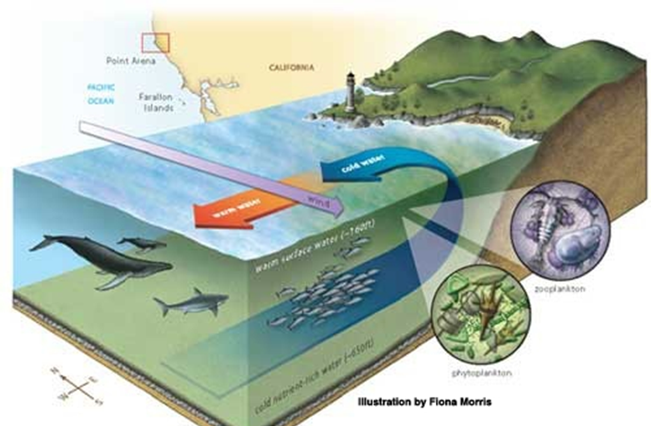
What upwelling does
Brings more dissolved nutrients such as nitrates and phosphates to the ocean surface
Responsible for the booming marine life population off the coast of California, Peru, and western Africa

Slide 4
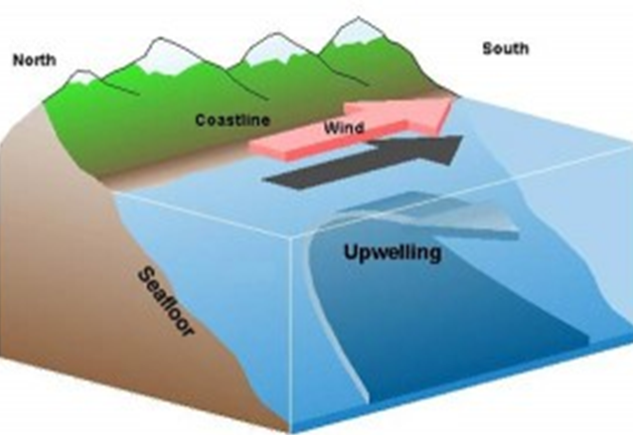
How upwelling happens
Wind moves blows along the shore
Coriolis Effect causes warm surface water to move away from shore.
Cold water rises up from below to fill in the area the warm water leaves

