Slide 1
Natural Water Quality
Physical, Chemical, and Biological Factors

Slide 2
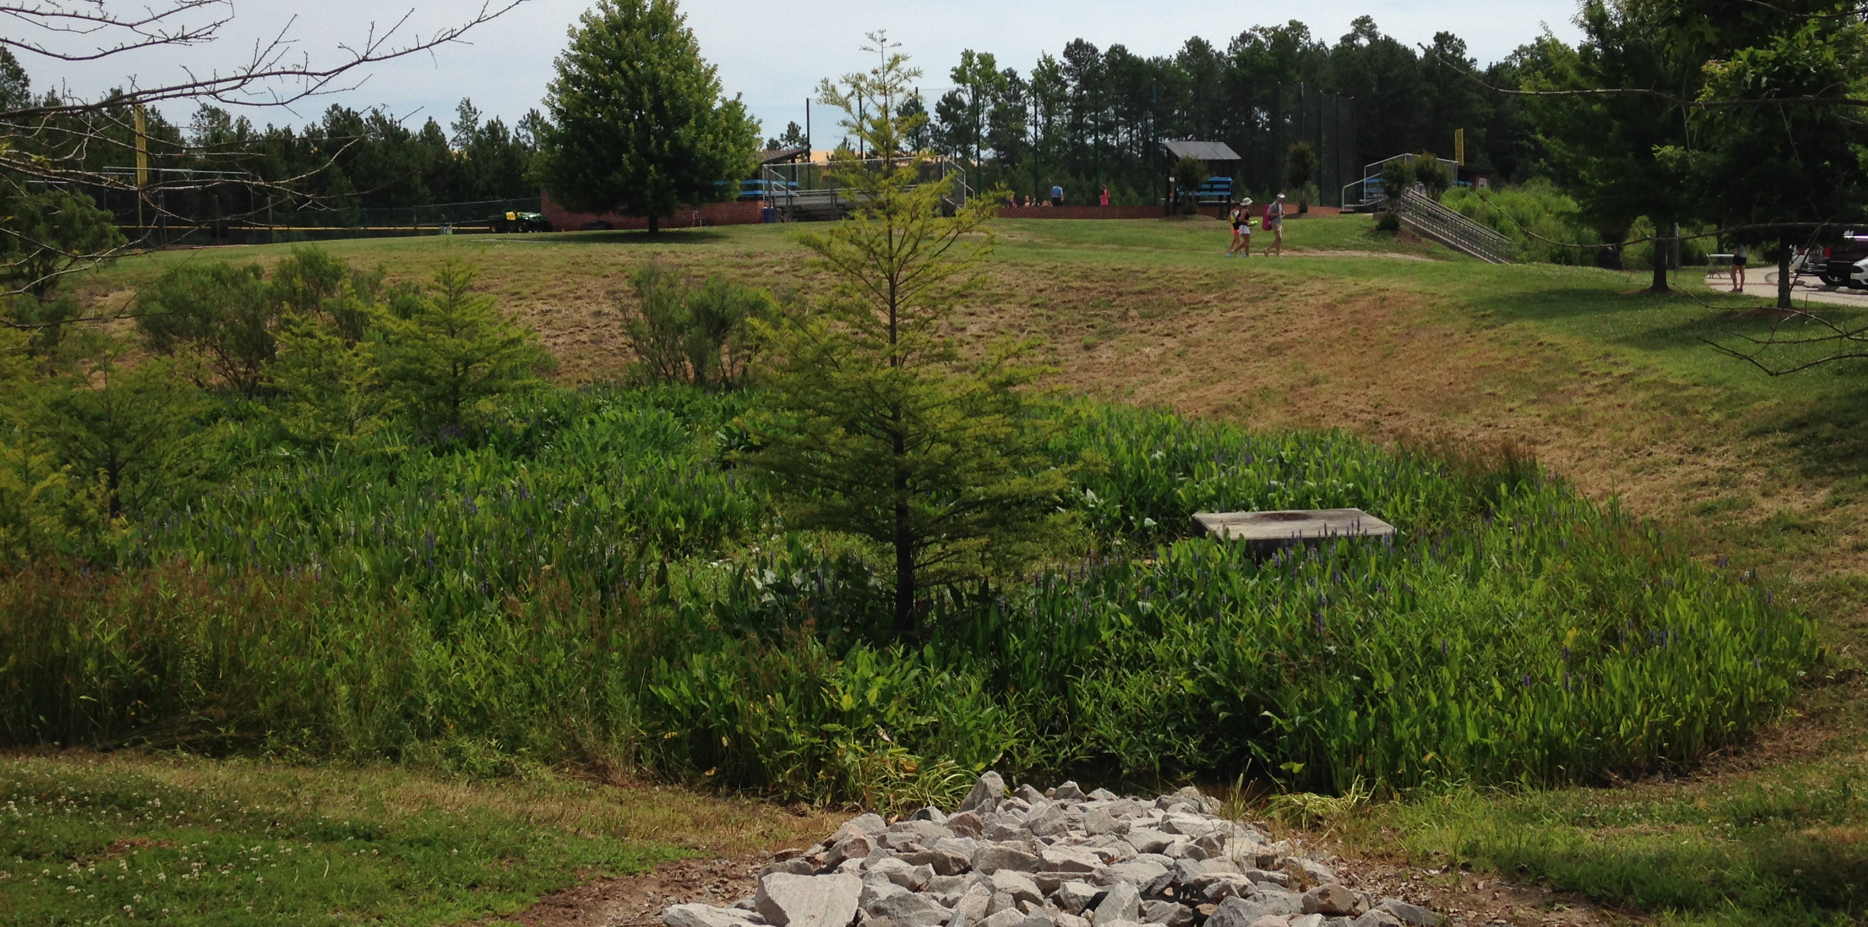
What is “Natural Water Quality”?
IS ability of water to support plant & animal life
IS NOT
How “clean” it is
If it looks pretty
If it’s safe for people to drink

Slide 3
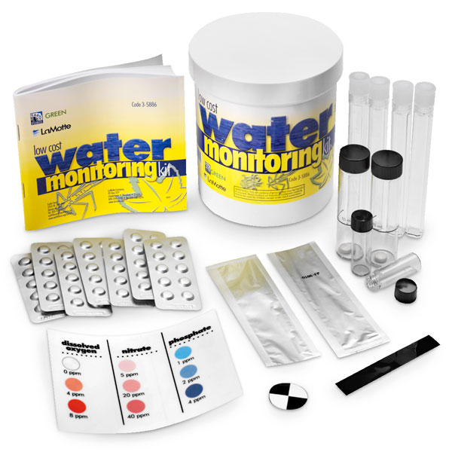
Factors Determining Water Quality
Dissolved Oxygen
Temperature
Turbidity
pH
Coliform bacteria
Nitrates/Phosphates

Slide 4
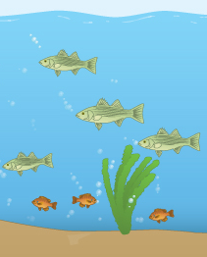
Dissolved Oxygen (DO)
. . . amount of oxygen IN water
Made by plants/algae via photosynthesis (use carbon dioxide and water to store sun’s energy as sugars & release oxygen to the environment)
Used by all life: plants, algae, animals, insects, bacteria, etc.
Without it, everything suffocates!!!

Slide 5
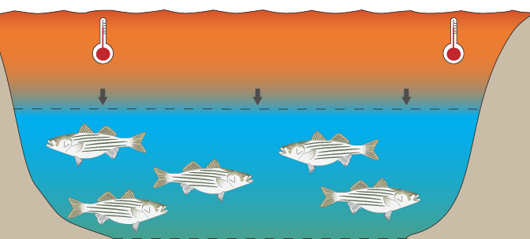
Temperature
Affects water quality in 2 ways:
Most important: temperature increases = water loses dissolved oxygen . . . (see previous notes on DO)
Too hot/too cold = individual organisms’ cells stop working = death

Slide 6
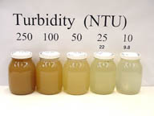
Turbidity
. . . amount of sediment in/cloudiness of water
As turbidity increases, two things happen:
Particles absorb sunlight = water heats up . . . (see temp/DO)
Particles shade underwater plants = no photosynthesis . . . (see DO)

Slide 7
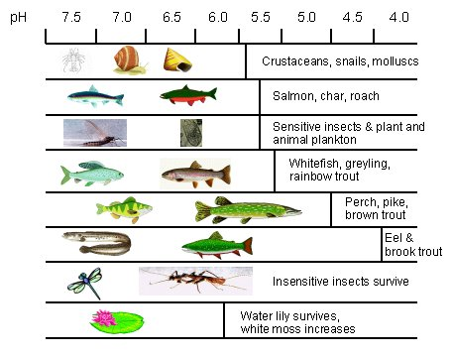
pH
. . . acidity of the water
<7 = acidic
7 = neutral
>7 = basic
Too high/too low = cells of all organisms break apart = death

Slide 8
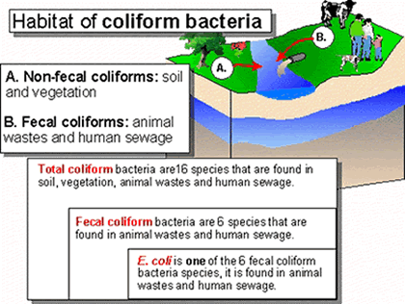
Coliform Bacteria
. . . not harmful BUT mean feces are likely
Feces often have other bacteria = animals become sick
Feces have lots of nitrates/phosphates . . . (see next slide)

Slide 9
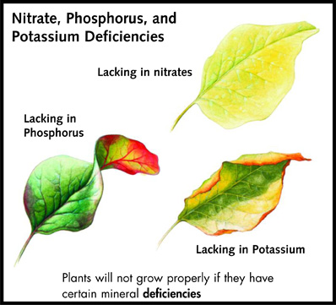
Nitrates & Phosphates
. . . chemicals necessary for plant/algae growth
Too little = plants cannot grow = no photosynthesis . . . (see DO)
Too much = algae grows out of control and causes an algal bloom . . .

Slide 10
Algal Bloom
uncontrolled growth of algae that eventually kills all organisms in the water

